Slide 1
Welcome

Slide 2
Note for the honourable teachers:
The subject teachers are requested to read the notes given below the slides.
Notes are given bellow the slide no. 4, 7, 10, 15, 16, 17 and 18 .

Slide 3
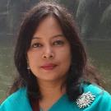
INTRODUCTION
ROUFUN NAHAR
ASSISTANT TEACHER ( ENGLISH)
MAZIDA GOVT. HIGH SCHOOL
TONGI, GAZIPUR
CLASS: SEVEN
SUBJECT: ENGLISH FIRST PAPER

Slide 4
Let’s watch a video clip.
1. What have you seen in the video?
Notes:
First the students will see the video. Then the teacher can ask the question to the whole class. SS will raise their hands. Teacher can ask 2/3 students to narrate the video.

Slide 5
Today our topic
What happens in Bangladesh?
UNIT: NINE
LESSON: 5

Slide 6
LEARNING OUTCOMES OF THE LESSON
By the end of the lesson the students will be able to
Talk about event.
Read and understand text.
Write about climate and environment.
Infer the meaning of some key words.

Slide 7
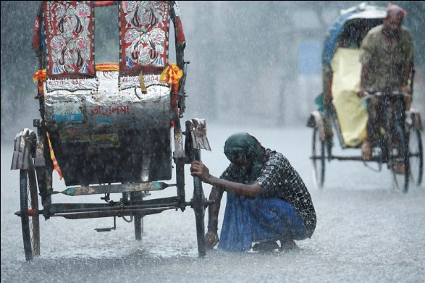
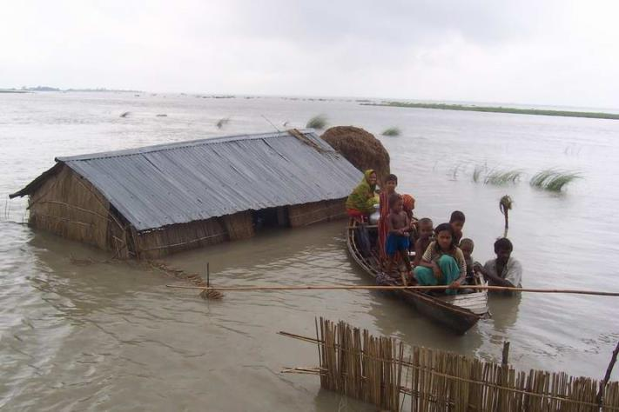
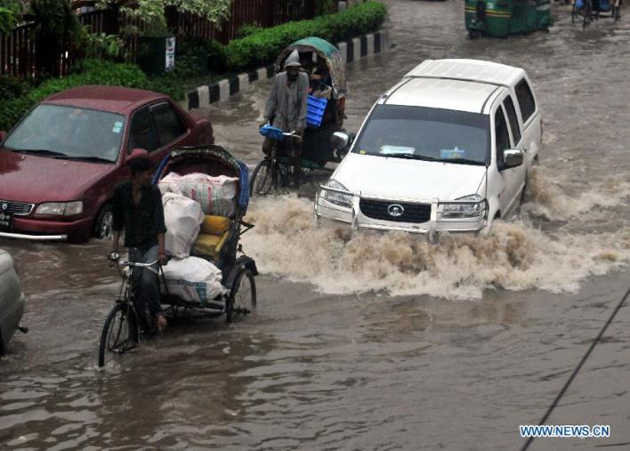
Can you say what happens in Bangladesh?
Flood
Water logging
Heavy rainfalls
Notes:
Showing the picture teacher can ask the given question to the whole class. The students will raise their hands. The teacher can ask 1/2 students to describe the picture. Then the teacher can show the answer as feedback. In the same way, slide no. 8 and 9 can be conducted.

Slide 8
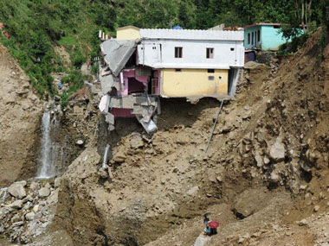
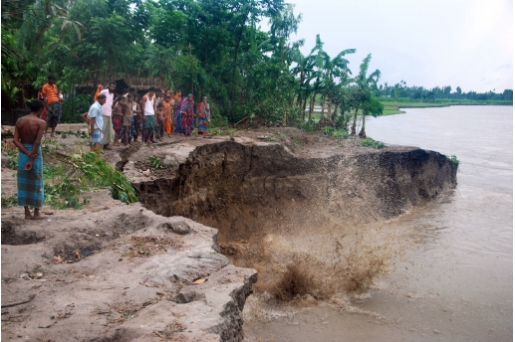
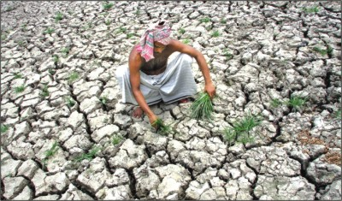
Can you say what happens in Bangladesh?
Drought
River erosion
Landslides

Slide 9
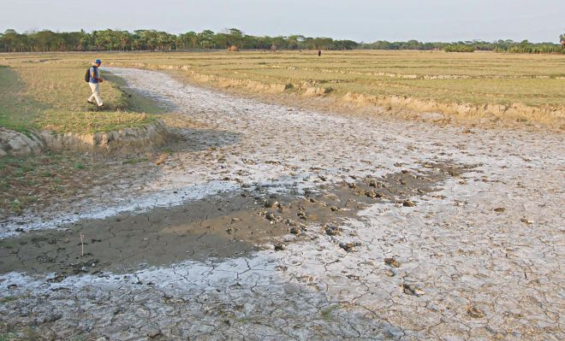
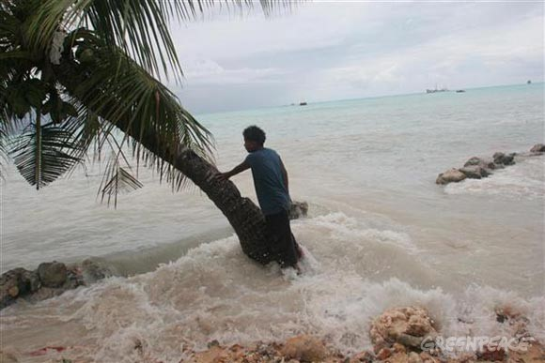
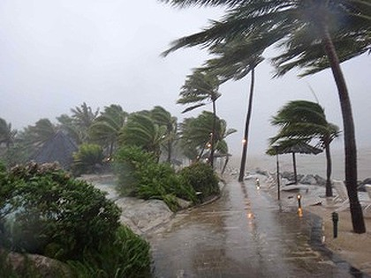
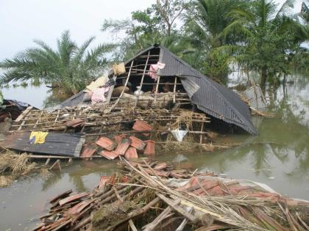
Can you say what happens in Bangladesh?
Cyclone
Rising sea level
Salinity of water

Slide 10
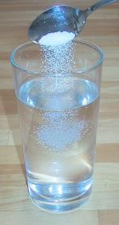
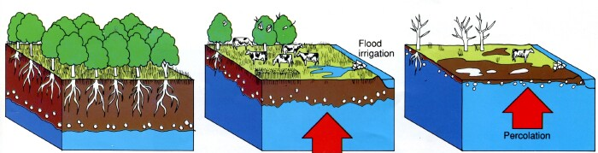
Salinity
Vocabulary
Meaning
Salinity is the saltiness of a body of water.
Salt
Salinity of ground water damages the crops and lives.
Salty ground water
Notes:
First, the word will be shown. The SS will be asked to pronounce the word. If it is needed teacher can help. Then the picture and the sentence will be shown and asked to guess the meaning. After that the meaning will be shown. Then the teacher can ask the students to make a sentence of their own. In the same way, slide no. 10-14 can be conducted.

Slide 11
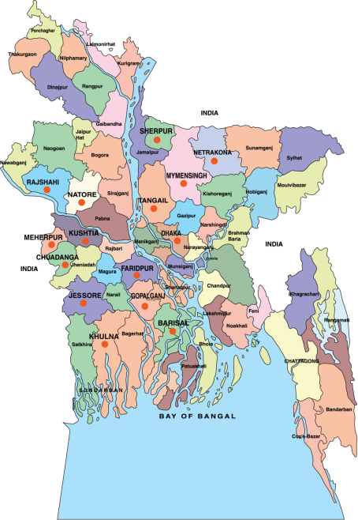
Coastal
Vocabulary
Meaning
relating to, or near a coast (sea side).
Cyclones usually hit the coastal area.

Slide 12
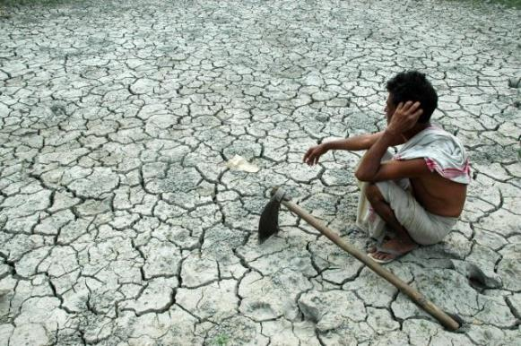
Adverse
Vocabulary
Meaning
preventing success or development; harmful; unfavorable
The land is adverse of growing crops.

Slide 13
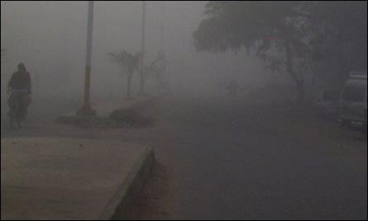
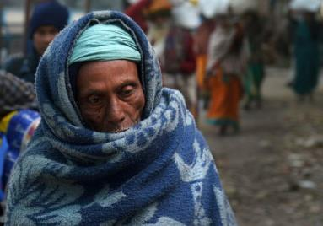
spell
Vocabulary
Meaning
a period of time
During the cold spell poor people suffer more.

Slide 14
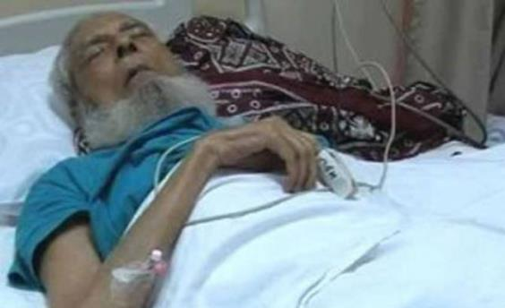
Prolonged
Vocabulary
continuing for a long time or longer than usual; lengthy.
Meaning
Prolonged illness is giving him much suffering.

Slide 15
Individual Work
Go to the textbook and read the passage from section A and write the answer of the following questions.
1. What cause the water logging and landslides?
Answer
Heavy rainfalls cause water logging and landslides.
2. What happened in 2009?
Answer
The Aila caused the damaged in 2009.
3. Why will millions of coastal people be homeless?
Answer
It is estimated that a 45 centimeters rise of sea-level will flood almost 10.9 percent of
our territory and will make 5.5 million people of our coastal regions homeless.
Notes:
The teacher can ask SS to go to the textbook , section A and read the passage. After reading the passage student will find out the answer from the passage. 10 minutes can be given for the task. Then the teacher can elicit answer from 4/5 students. Then teacher can show the answers.

Slide 16
Pair Work
Read the text again from the textbook , section A and choose the best answer from the alternatives given in section B.
Notes:
The teacher can ask SS to read the passage again and find out the best answer from the alternatives given in section C. The students will find out the answer from the passage. 3/4 minutes can be given for the task. Then the teacher can elicit answer randomly.

Slide 17
Let’s watch a video clip.
1. What have you seen in the video?
Notes:
First the students will see the video. Then the teacher can ask the question to the whole class. SS will raise their hands. Teacher can ask 1/2 students to narrate the video.

Slide 18
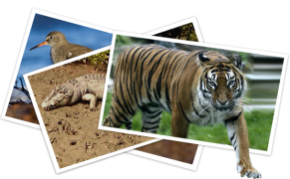
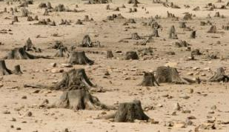
Group Work
In small groups discuss and write the answer of the following question.
1 What problems do you think deforestation can cause in Bangladesh? Which animals in Bangladesh are in danger of extinction? What do you think we should do to protect these animals?
Notes:
The teacher can make few groups. The groups may have 5/6 members. They will discuss in groups and write the answer. Teacher can give them 8 minutes to complete the task. The elicit answer from 2/ 3 groups.

Slide 19
Home Work
Write five slogans to make people aware of the problems of climate change.
1. ……………….
3. ………………..
2. ………………..
4. ……………….
5. ……………….

Slide 20
Acknowledgement
MoE, DSHE, NCTB & A2I respective of officials
And the editors panel: Ranjit Poddar, Associate Professor (English) TTC, Dhaka, Md. Jahangir Hasan (English), Assistant Professor TTC, Rangpur and Urmila Khaled Assistant Professor (English) TTC, Dhaka.
Their direction, valuable suggestions and intensive supervision have enriched the model contents.

Slide 21
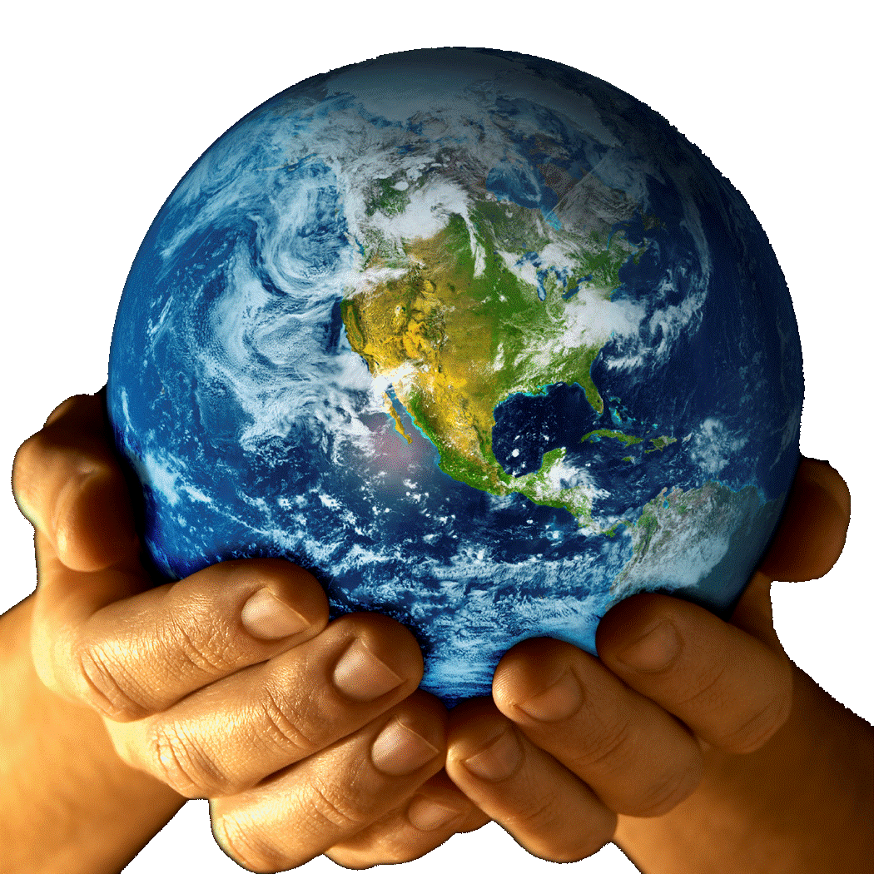
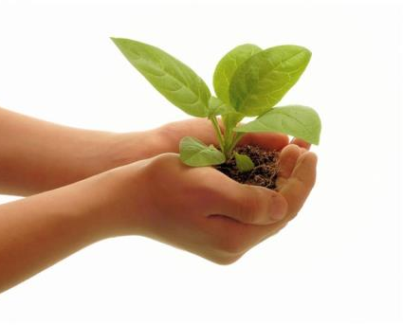
Plant more trees and save the earth.
Thank you all

